Slide 1
Chapter 3
Introduction to Logic
Section 3-3
The Conditional Statement

Slide 2
The Conditional Statement - Objectives
Understand the structure of the conditional statement.
Rewrite a statement using the if...then connective.
Determine the truth values of conditional statements.
Convert symbolic conditional statements into words.
Express a conditional statement as a disjunction.
Express the negation of a conditional statement.

Slide 3
The structure of the Conditional
A conditional statement is a compound statement that uses the connective if…then.
The conditional is written with an arrow, so “if p then q” is symbolized:
We read the above as “p implies q” or “if p then q.” The statement p is the antecedent, while q is the consequent.

Slide 4
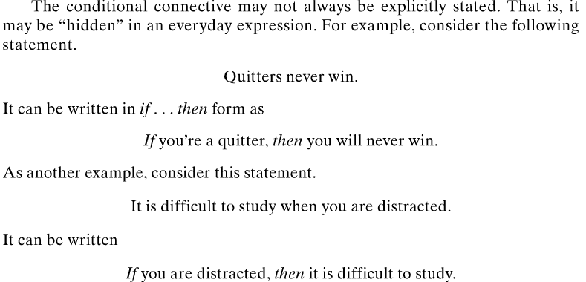
Rewriting a Statement Using if...then

Slide 5
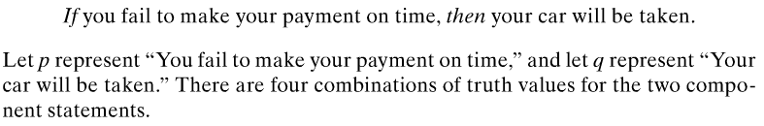

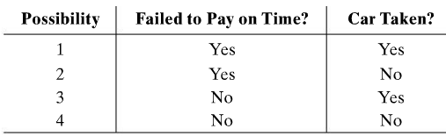
Truth Values for the Conditional Text pp. 102-103

Slide 6
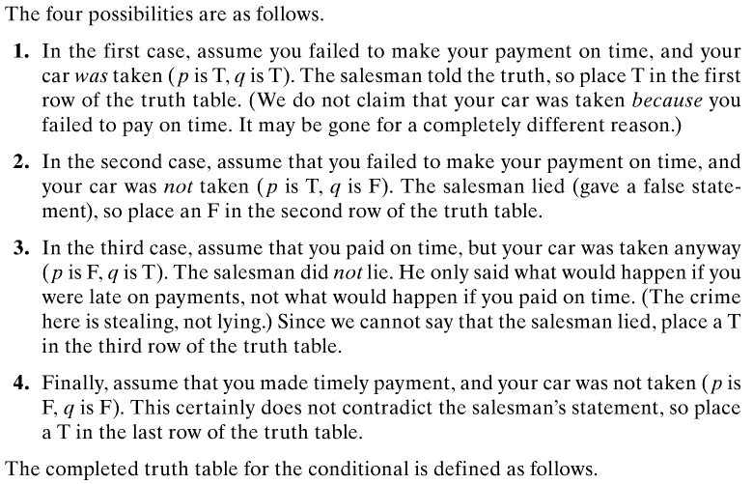
Truth Values for the Conditional Text pp. 102-103

Slide 7
Truth Table for The Conditional: If p, then q
** NOTECARD !! **
If p, then q
p q
T T | T
T F | F
F T | T
F F | T
The only time a conditional (p → q) is FALSE is if the antecedent (p) is true and the consequent (q) is false.

Slide 8
Special Characteristics of Conditional Statements
is false only when the antecedent (p) is true and the consequent (q) is false.
If the antecedent (p) is false, then is automatically true.
If the consequent (q) is true, then is automatically true.
(When in doubt with any of these, use your truth table – previous slide)

Slide 9
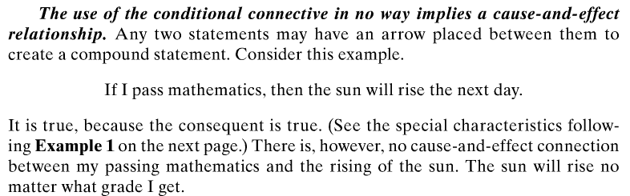
What about cause and effect? Text p. 103

Slide 10
Convert (Translate) Symbolic Conditional Statements into Words
This process is very similar to what we’ve done already in Section 3.1.
We will look at some of these in MML.
You will also do the “vice-versa” of this; that is:
Convert (translate) statements in words into symbolic conditional statements.

Slide 11
Tautology
A statement that is always true, no matter what the truth values of the components, is called a tautology. They may be checked by forming truth tables.
Writing a Conditional as a Disjunction: “Or” Statement
** NOTECARD !! **

Slide 12
Example: Determining Negations
Negation of a Conditional
The negation of
** NOTECARD !! **
Determine the negation of each statement.
a) If I’m hungry, I will eat.
b) All dogs have fleas.
Solution
a) I’m hungry and I will not eat.
b) Restate as an if…then:
If it is a dog, then it has fleas.
Negation: It is a dog and it does not have fleas.

Slide 13
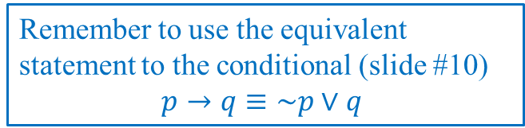
Example: Determining Statements Equivalent to Conditionals
Write the conditional as an equivalent statement without using if . . . then.
If the Indians win the pennant, then Johnny will go to the World Series.
Solution
Let p represent “The Indians win the pennant” and q represent “Johnny will go to the World Series.
Restate: The Indians do not win the pennant or Johnny will go to the World Series.
Remember to use the equivalent statement to the conditional (slide #10)
$$p→q≡\sim p∨q$$

